Slide 1
The Need to Know: How to Create Digital Escape Room Activities to Highlight Fundamental Knowledge and Foster Curiosity
Julie Stephens de Jonge, PhD
Professor of Spanish
University of Central Missouri
jstephens@ucmo.edu

Slide 2
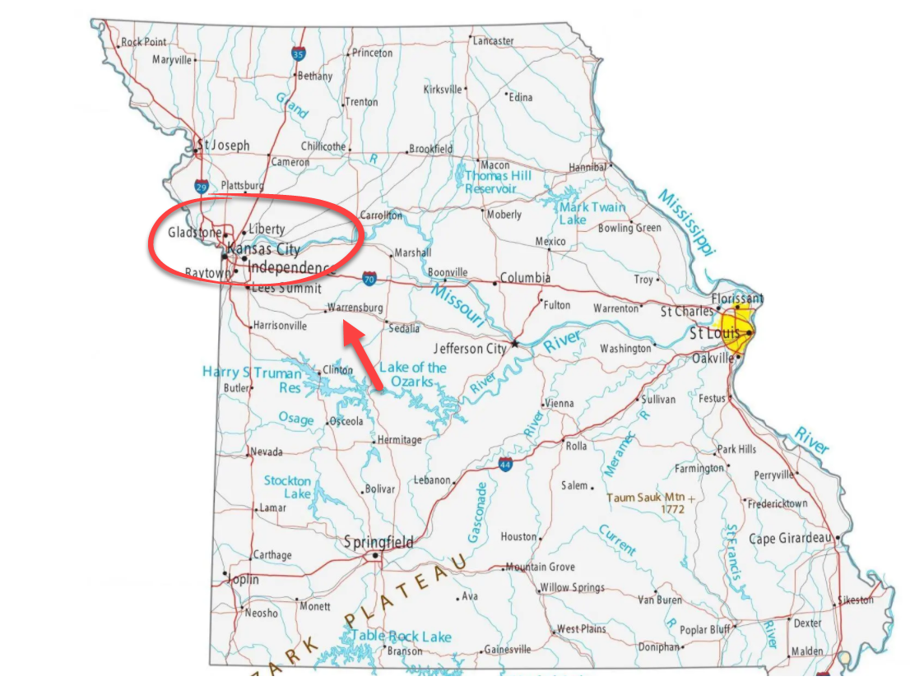
Introduction
I teach all levels of Spanish in an undergraduate program at the University of Central Missouri
Language
Culture
Literature
Film

Slide 3
Plan for today but open to other paths!
Escape room concept
Pedagogical / Cognitive Foundations
Examples
How to?
Breakout Chat: Brainstorm ideas and questions
Q & A

Slide 4
Escape Rooms
The Escape Room Concept
“Escape rooms are a whole new way of experiencing storytelling. By combining a social activity with interactive adventures and challenging puzzles, escape game players are immersed in an entirely different world with storylines that feel like Hollywood blockbusters.” https://theescapegame.com/blog/what-is-an-escape-room/
That’s a lot of pressure!

Slide 5
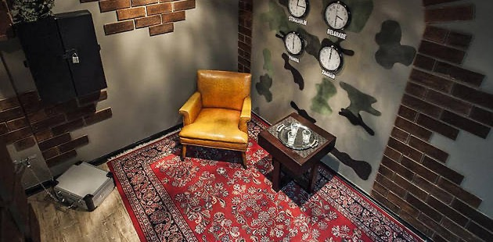

Slide 6
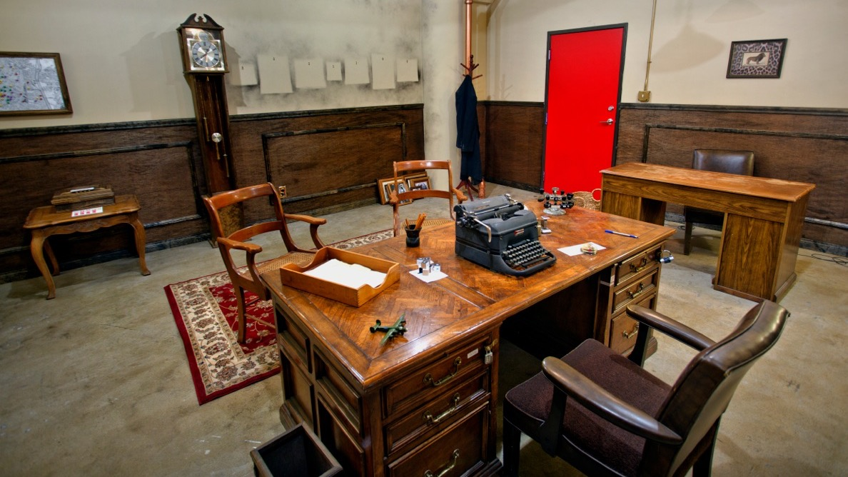
This Photo by Unknown Author is licensed under CC BY-NC-ND

Slide 7
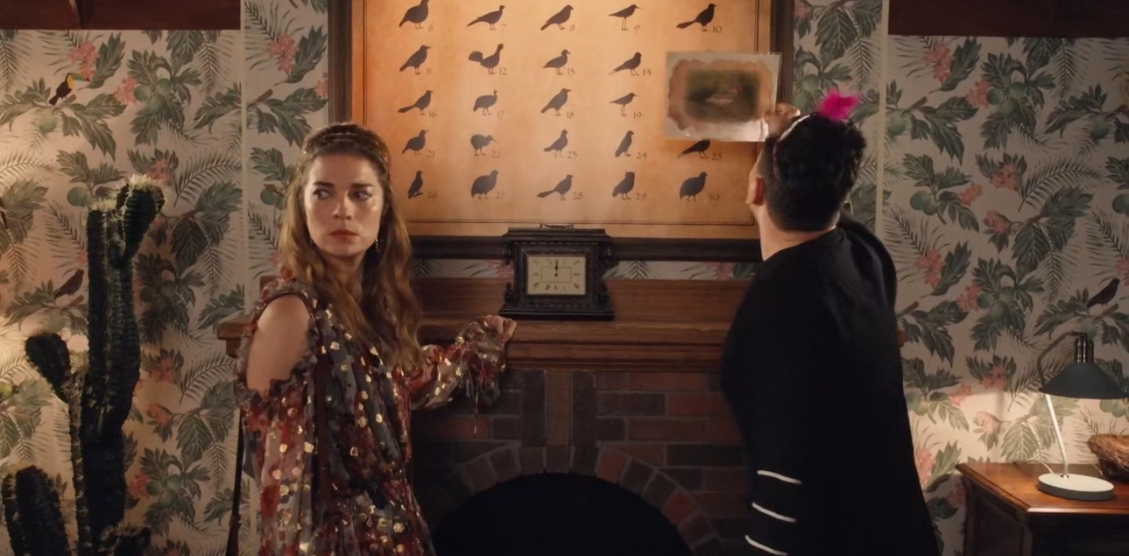

Slide 8
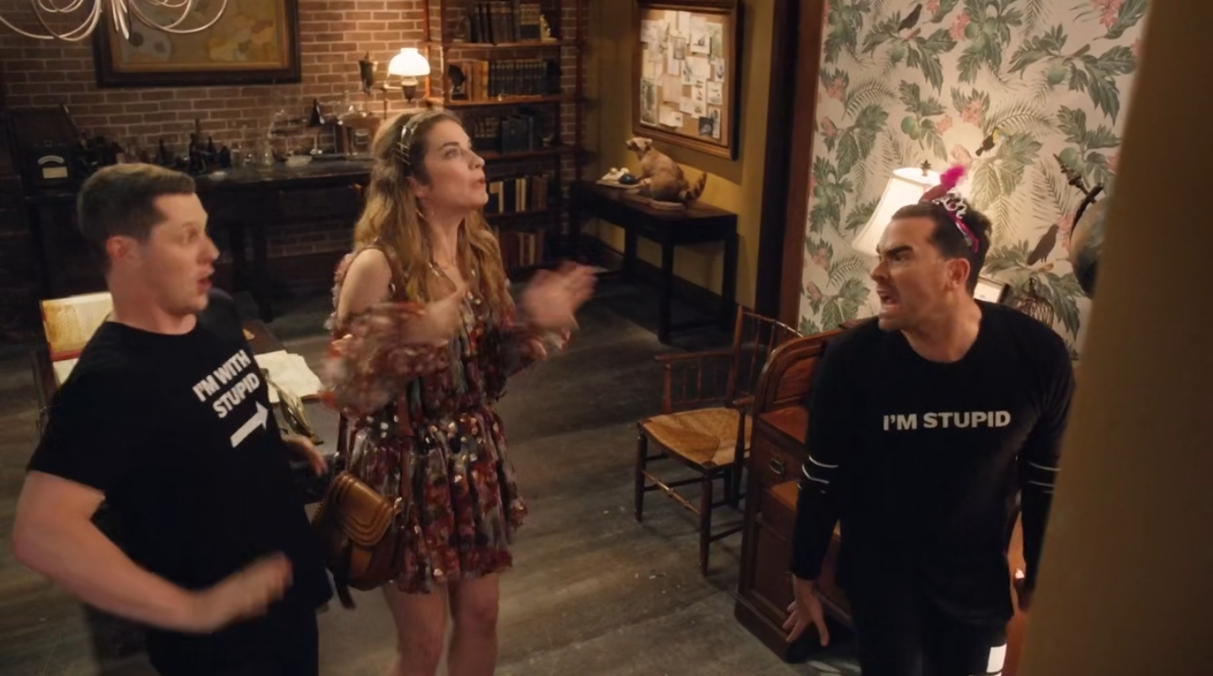

Slide 10
Multiple Platforms to use
Content can be added to one or more online platforms.
Platforms can be connected / linked to one another

Slide 11
Links The power of the URL
No programming needed!
images – forms – puzzles – videos – documents

Slide 12
Digital Escape room
Journey / Path with stops along the way
The stops are information or skills and function like breadcrumbs

Slide 13
Connect virtual and real world

Slide 14
Pedagogical Foundation
Emotions
Cognitive / Emotional Nexus
Visual Input

Slide 15
Emotions
Hold attention
Increase memory
Motivate
Spark curiosity
Curiosity—one of knowledge emotions
Surprise, interest, confusion, and awe
Notes:
https://nobaproject.com/modules/knowledge-emotions-feelings-that-foster-learning-exploring-and-reflecting

Slide 16
How to engage emotions? How to link course content to emotions
Story
Mystery
Surprise

Slide 17
Lateral thinking
Use course content to solve a problem.
Or solve a problem to discover and reinforce course content.
The puzzles, enigmas, problems and the course content work in tandem to create an experience of play and discovery.

Slide 18
Images / Visual Input
Hidden pictures
Fun to find something!
Images can be related or unrelated to your course topic

Slide 19
Visual input
Humans process visual information more efficiently than text.
"The brain is set up in a way
that visual stimuli and emotional response
is easily linked,
and together the two form memories."
https://www.shiftelearning.com/blog/bid/350326/studies-confirm-the-power-of-visuals-in-elearning

Slide 20
Familiarity + Novelty
Mix the predictable and the unexpected
Create surprises
“The area of the brain that anticipates rewards is the same area that processes novelty.” --Carmen Simon, author of Impossible to Ignore: Creating Memorable Content to Influence Decisions, p. 99.

Slide 21
Design challenge
Goldilocks problem.
Not too hard, not too easy.
Include some easy puzzles.

Slide 22
Examples
Multiple platforms
Links

Slide 23
A story can be simple or expansive
Pretext for learning about or sharing information
Puzzles / Activities can require knowledge or contribute to knowledge.

Slide 24
Content knowledge
Next Step
More content knowledge, review, skills
Prior / General Knowledge
Next Step
Knowledge, review, skills

Slide 25
Two types of “home base”:
1. Google Slides
2. Google Sites

Slide 26
Short example with Google Sites
Fifteen-minute class activity
Cusco, Perú
Inca culture
Discrimination of indigenous people in Latin America
Click here
This Photo by Unknown Author is licensed under CC BY-NC

Slide 27
Google Slides
Option 1: create rooms with images and links.

Slide 28
Example from course-long activity
Find four artefacts that are hidden somewhere in the Spanish-speaking world
Original copies of Don Quijote and the Popul Vuh
A painting by Frida Kahlo and Salvador Dalí

Slide 31
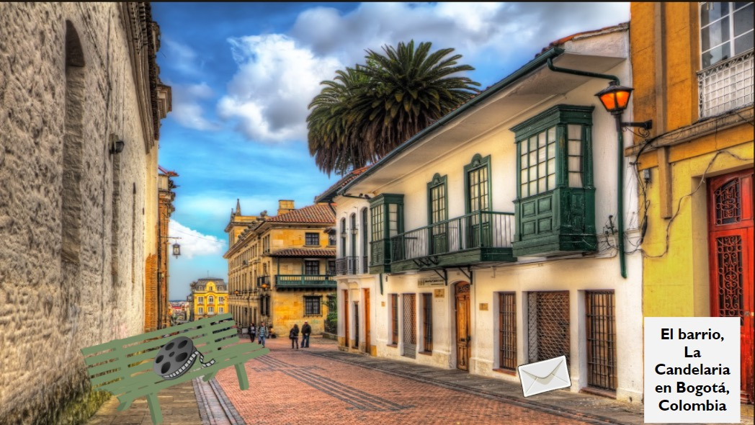

Slide 32
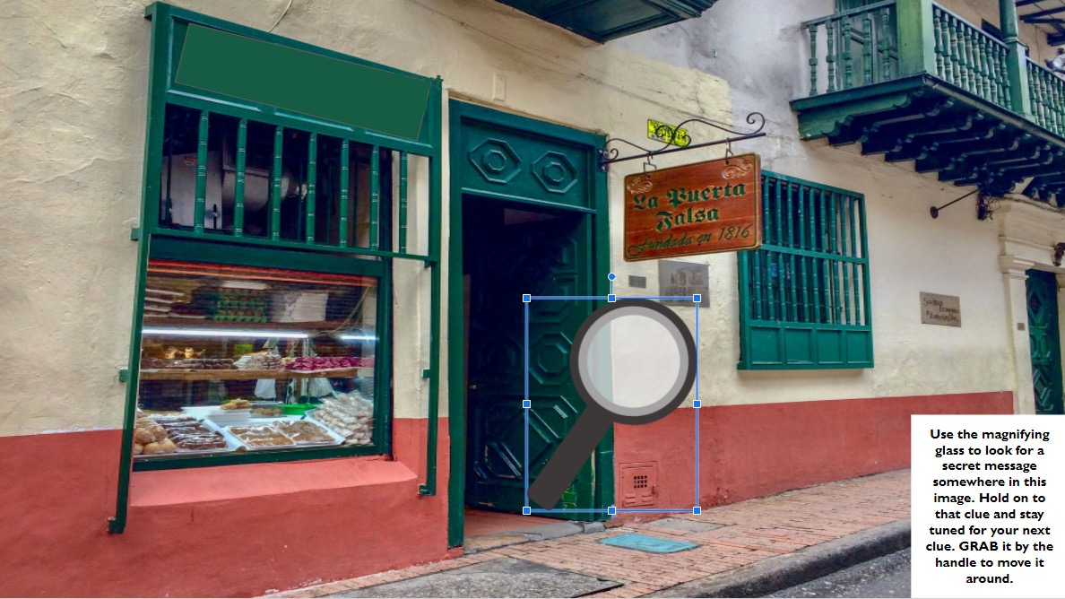

Slide 33
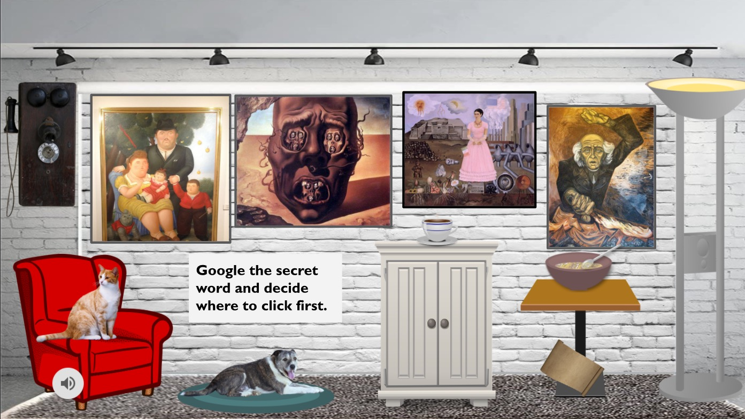

Slide 34
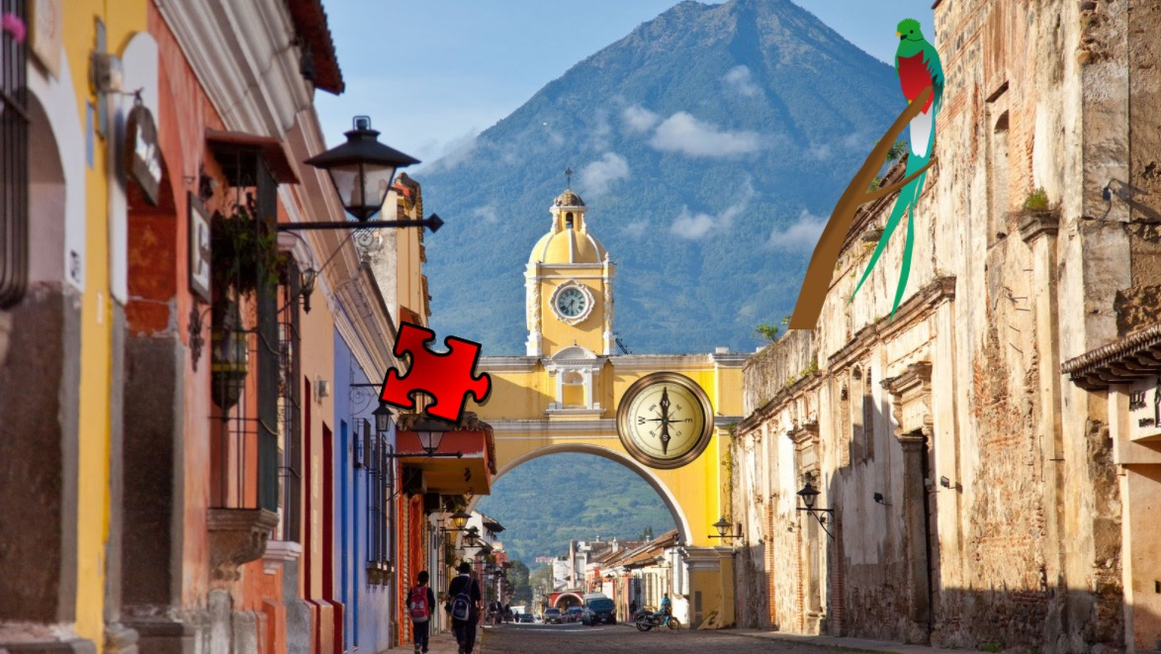

Slide 35
Here is your secret message!

Slide 36
Surprise text!

Slide 37
Write your secret message here!

Slide 38
Google Slides
Create a room with a floor and wall
Look for “transparent images”

Slide 39
Google Sites
ExampleS
Page 1 / Page 2

Slide 40
Dystopian world example

Slide 41
Collaboration project between US students and students in Spain.
Google Sites with hidden navigation: EDIT
Google Sites: PUBLISHED VERSION

Slide 42
Software Tools
Free
Not Free
Google Suite: Sites, Slides, Forms, Drawings, and Maps
Jigsaw Planet
Natural Reader or other text to voice application
Creative Commons Images
Camtasia: Video Editing: $99 (one time)
Snagit: Desktop capture, image editing: $29.99
Breakoutedu: $99 / year
Doodly: $67 (one time)
Powerpoint

Slide 43
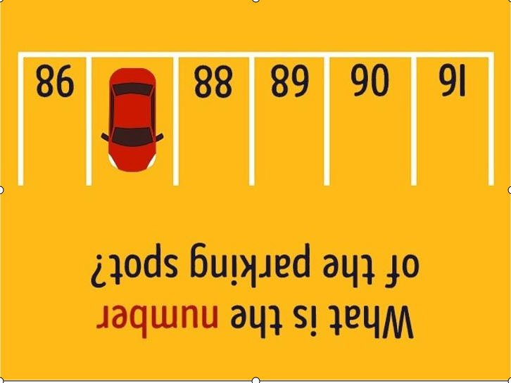
Parking lot question https://forms.gle/73BiqVJhTpsJLPjEA

Slide 44
Bookshelves: Good place to hide things
Bookshelf example 1: Google drawings
Mathematics question with an answer that leads them to another step.
Bookshelf example 2: Google drawings
Specific content knowledge is not needed to play

Slide 45
Images
Breakoutedu
Shapes
Numbers
1234
Colors
Directional Arrows
Letters
A B C D

Slide 46
Breakoutedu.com
Example 1

Slide 47
Jigsaw Planet
El norte
Los mejillones
Guernica

Slide 48
Doodly
Draw your own cartoon videos (whiteboard animation software)

Slide 49
Secret messages with red decoder
Google Drawings

Slide 50
Collaboration Examples
Students need one another to solve a puzzle

Slide 51
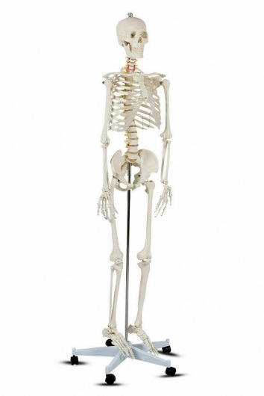
Who-done-it mystery
Something is stolen
Each person has an identity and a piece of information or knowledge
Image
Word
Fact
Example: Anatomy class
Someone stole the class skeleton
Every student is given a different organ and a clue

Slide 52
Stolen Skeleton
Several options
Groups of five to seven.
Everyone has a different clue. Together, they reveal the identity of the thief.
They must figure out which organ each student has by asking yes/no questions. Once they guess the organ, the student shares a clue.
The clue could be a word that combines with other words to form a sentence:
The thief is the person who sits behind David.
Or, the clue could be a jigsaw puzzle of the human body that reveals a clue.

Slide 53
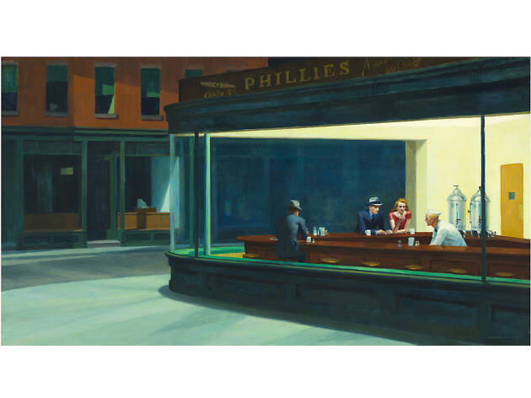
Stolen work of art
Each student has a different masterpiece.
The student has a digital jigsaw puzzle of the masterpiece with a clue.
Students first answer questions about works of art or art concepts on a Google form.

Slide 54
Instructional Videos
Google Drawings
Google Forms–Response Validation
Jigsaw Planet (and how to add a clue to a jigsaw puzzle)
Google Sites

Slide 55
Links to story / theme / puzzle ideas
Lock Paper Scissors
Lock Paper Scissors puzzle examples
Ideas for an Escape Room Business—may be able to borrow these for classroom setting
General Themes and Frameworks
23 Ideas
101 Escape Room Activities
Cipher Ideas

Slide 56
Breakout Room Discussion
10 minutes
Discuss ideas from your discipline
Come up with questions and write in the chat box.

Slide 57
Questions?
jstephens@ucmo.edu

